Slide 1



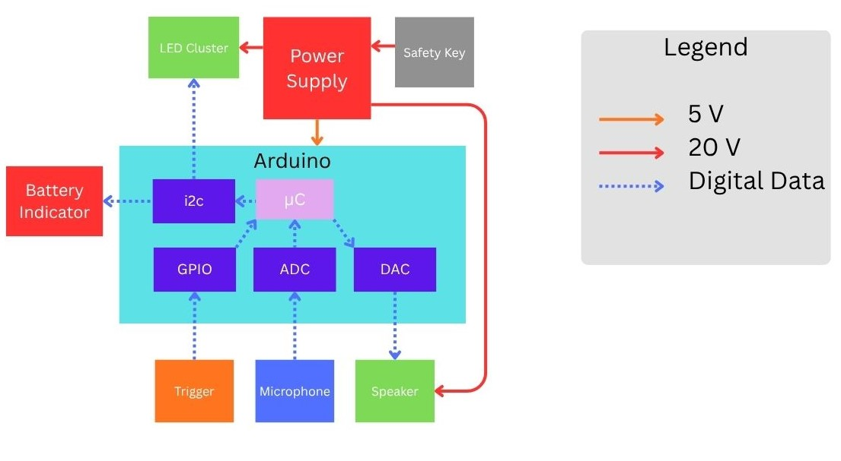
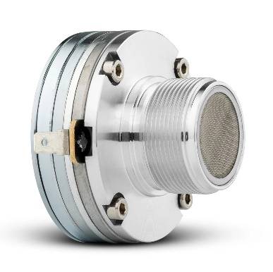
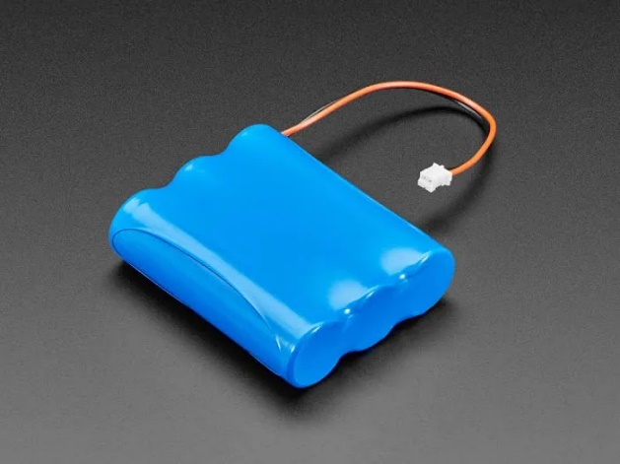
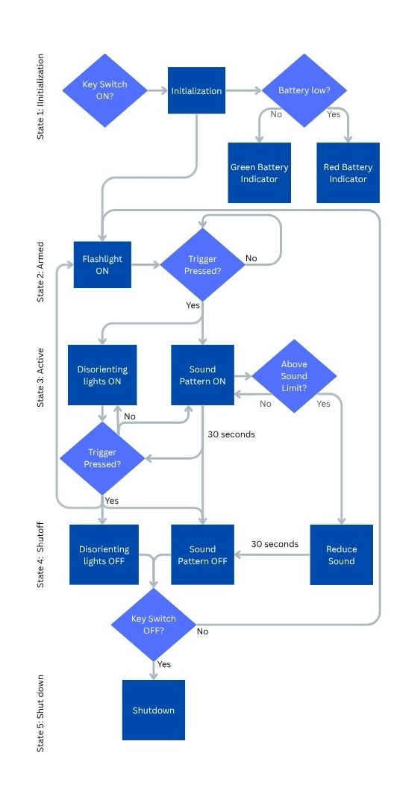
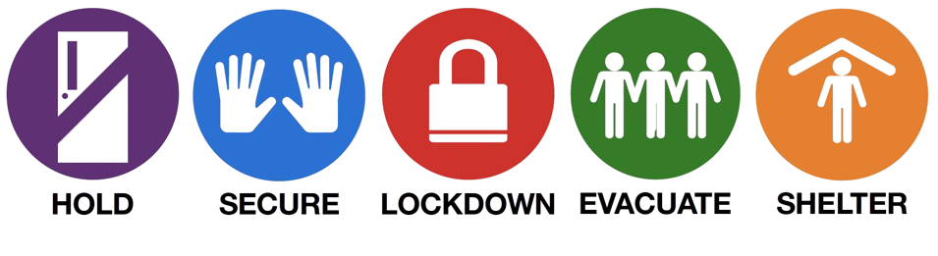
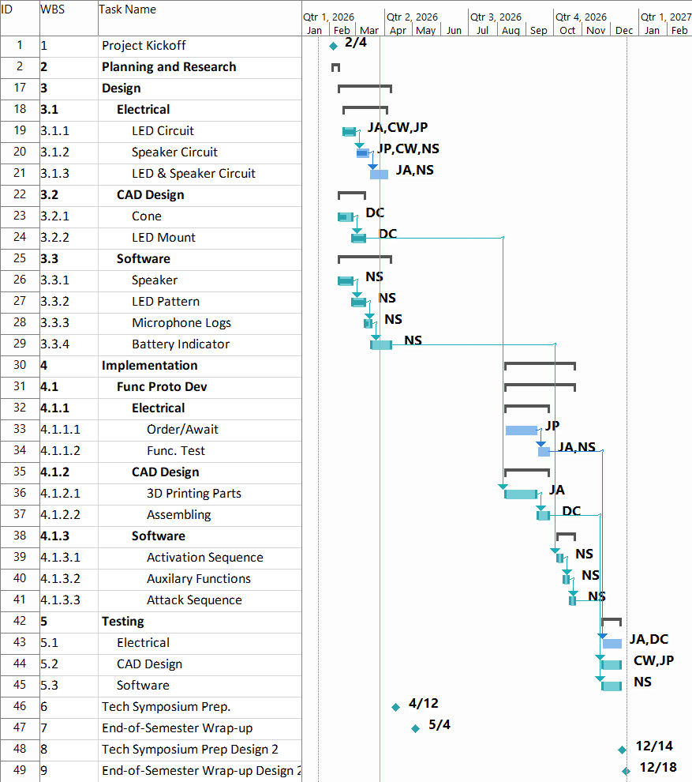
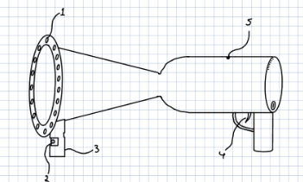
Self-Defense Device (Zeus)
Noah Schatz, Diego Cummins, Jessy Pena, Jose Aguirre, Christina Walker
Abstract
Hardware Diagram
Competing Products
Abstract
Hardware Diagram
Competing Products
Product | Area Denial | Ease Of Use | Range | Effectiveness
Beam Q Laser "Dazzler" | POOR: needs pin-point accuracy | DECENT: one button to turn on | GREAT: 100-300m
Axon-Taser Pulse 2 | POOR: affects only one target | GREAT: like a gun, one trigger | POOR: 15ft, close to mid range
Mace Pepper Gel | DECENT: can slow/stop target | GREAT: flip top with button to fire | POOR: 12-15ft (small canister), 25-30ft (large)
Fenix Pro Flashlight | POOR: has no area denial | DECENT: switch with 6 modes
Zeus is a handheld self-defense device designed to protect school staff and civilians during active threat situations. It uses high-intensity sound and strobe lighting to temporarily disorient an attacker from a safe distance, buying critical time until law enforcement arrives. This device addresses the lack of effective, less-lethal safety tools. It focuses on a solution that is both easily accessible and compliant with regulations. Zeus is designed to be easy to use in high-stress situations, combining ergonomic controls, built-in safety features, and regulated output to ensure effectiveness without causing permanent harm to the aggressor or bystanders
Need for Product
Main Components
Need for Product
Main Components
School staff currently lack effective and practical tools to respond during active threat situations. Existing self-defense options introduce safety risks, require close proximity, or are not permitted in school environments. This leaves a critical gap in protection while law enforcement arrives. These few minutes pose the highest risk to the safety of staff and students. A compliant, less-lethal, and user-friendly solution is necessary to enhance safety and response capability
Figure 3: Hardware Diagram
Trigger (1$)
Microcontroller (15$)
Speaker Unit (100$)
White/Green LED Clusters (300$)
Battery Pack (150$)
Microphone (10$)
Battery Indicator (5$)
Software Flowchart
Figure 5: Speaker Unit
Software Flowchart
Figure 6: Battery Pack
Work Breakdown Structure
Work Breakdown Structure
Figure 1: Standard Response Protocol (SRP)
Product Requirements
Product Requirements
The Zeus system is designed to provide a less-lethal method of defense during active threat situations using directional high-intensity sound and strobe lighting to disorient an aggressor from a safe distance. It must operate reliably in high-stress environments, remain easy to use, comply with institutional and legal regulations, and ensure output levels are controlled to prevent permanent harm to the user and bystanders.
Directional high-decibel sound output (100–134 dB)
High-intensity strobe lighting for disruption
Simple trigger-based activation
Portable battery-powered design
Built-in safety monitoring
Figure 7: Work Breakdown Structure
Acknowledgements
The Zeus team would like to give a special thanks to Bret Van Delden for the technical and financial support of our project. We would also like to recognize the UTSA Makerspace, Student Success Center and UTSAECE department faculty and staff for providing the resources, instruction and support related to this project.
Figure 2: Product Design Concept
Figure 4: Software Diagram

